Slide 1


Project Team:
1. Vineeth Kattubadi (EmpId:46336517)
2. Dayanand Velamala (EmpId:46336033)
3. Praveena Subramani (EmpId:46336018)
4. Anusha Majjiga (EmpId:46335968)
5. Thanmay Chennuri (EmpId:46335969)
ONLINE EXAM PORTAL

Slide 2
LIST OF CONTENTS
Problem Statement
Tech Stack Overview
Functional Requirements
ER Diagrams
Class Diagram
Sequence Diagram
Architecture layers
Challenges Faced
Scrum Meeting

Slide 3
PROBLEM STATEMENT
The Online Examination system should allow the user to register and login into the system. The system should show all the different kind of tests available in the system and the user must be able to take the tests. The exams list should be maintained regularly by the system. The user should be allowed to take the test only once. After the test the system must display the results.
The system should allow the creation of new users in the system. It should be accessible by two kinds of users
1. The admin
2. The users.
The administrator should be able to upload the question bank. The admin should also be able to the tests and make changes accordingly. The admin should also manage the users.

Slide 4
FUNCTIONAL REQUIREMENTS
An organization desires to introduce an online test/exam portal.
ADMIN
1.Login and can create the test ,delete the test ,add the questions , add the tests, manage the users .
USER
1. A user should be able to self-register and activate his account with email verification.
2. Once activated account, user should be able to login to the portal with selected credentials.
3. User would be authenticated based on username/password.
4. User would be authorized based on his role (i.E. Roles: user, administrator) .
5. After login user should land up on home page with links to view his historical tests/results and new tests enrolment.
6. Any user should be allowed to appear for any test only once.
7. The questions should be selected randomly.
8. Answers auto saved on each answer selected by user.
9. At the end of exam, all answers submitted, and results i.E. Final score presented

Slide 5
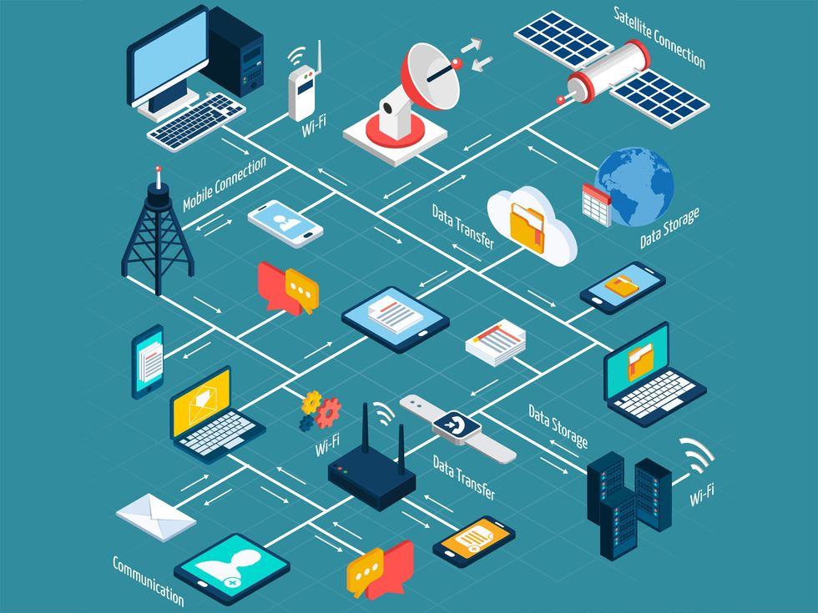
TECH STACK OVERVIEW
Technologies Deployed in Our Project
JDK17
Spring Boot
Postman
PostgreSQL
Maven
JUnit
Dependences
Spring Web
Spring Data JPA
PostgreSQL Driver

Slide 6
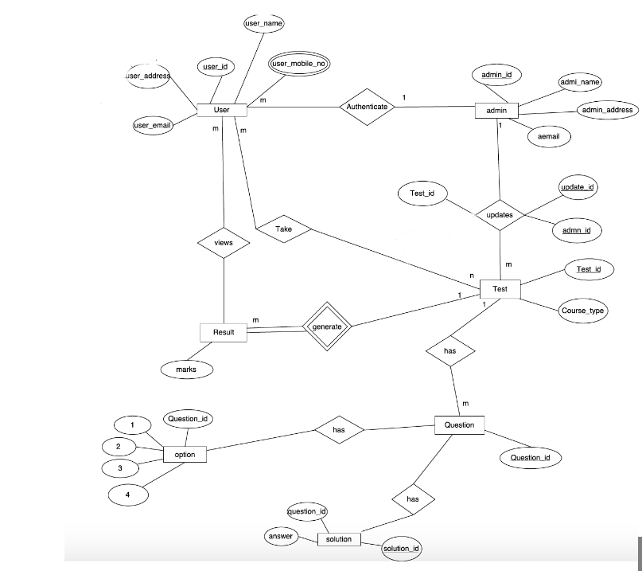
ER-DIAGRAM

Slide 7
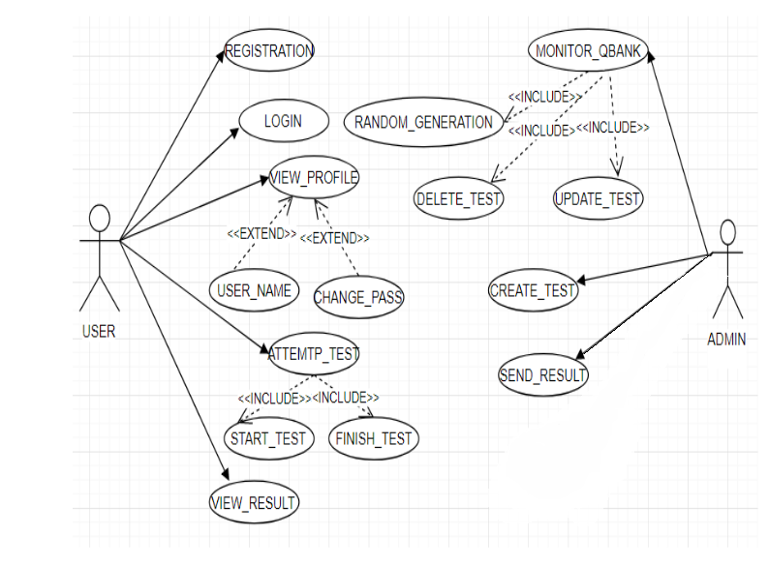
USECASE DIAGRAM

Slide 8
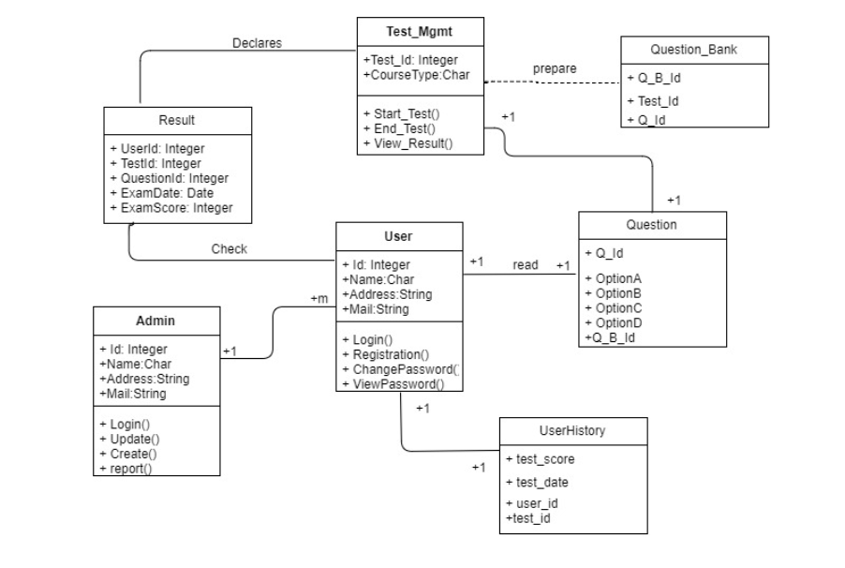
CLASS DIAGRAM

Slide 9
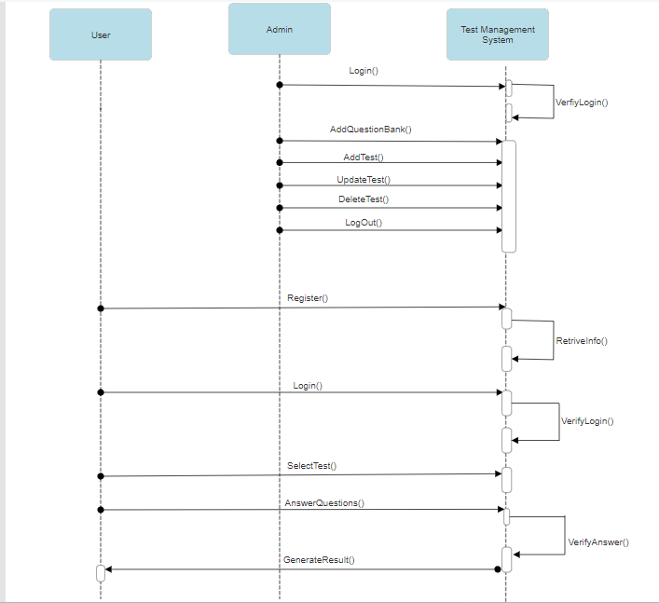
SEQUENCE DIAGRAM

Slide 10

APPLICATION ARCHITECTURE
API:
Different types of APIs used like:
Register and login user
Adding and deleting test
DATABASE
(POSTGRESQL)
BUSINESS LOGIC
POST MAN
Client
REPOSITORY LAYER
CONTROLLAYER
SERVICE
PERSISTENCE Logic:
Data Base:
JSON will SHOW OUT PUT IN JSON FORMAT

Slide 11

ARCHITECURAL LAYERS IN ACTION
              Entity Layer
              Data Transfer Object Layer
              Repository Layer
              Global Exception Handler
              Service Interface Layer
              Service Implementation Layer
              Controller Layer

Slide 12

ARCHITECURAL LAYERS IN ACTION
Entity Layer @Entity
  Admin
  Test
  User Results
  User
  Updates
  Questions
  User history

Slide 13
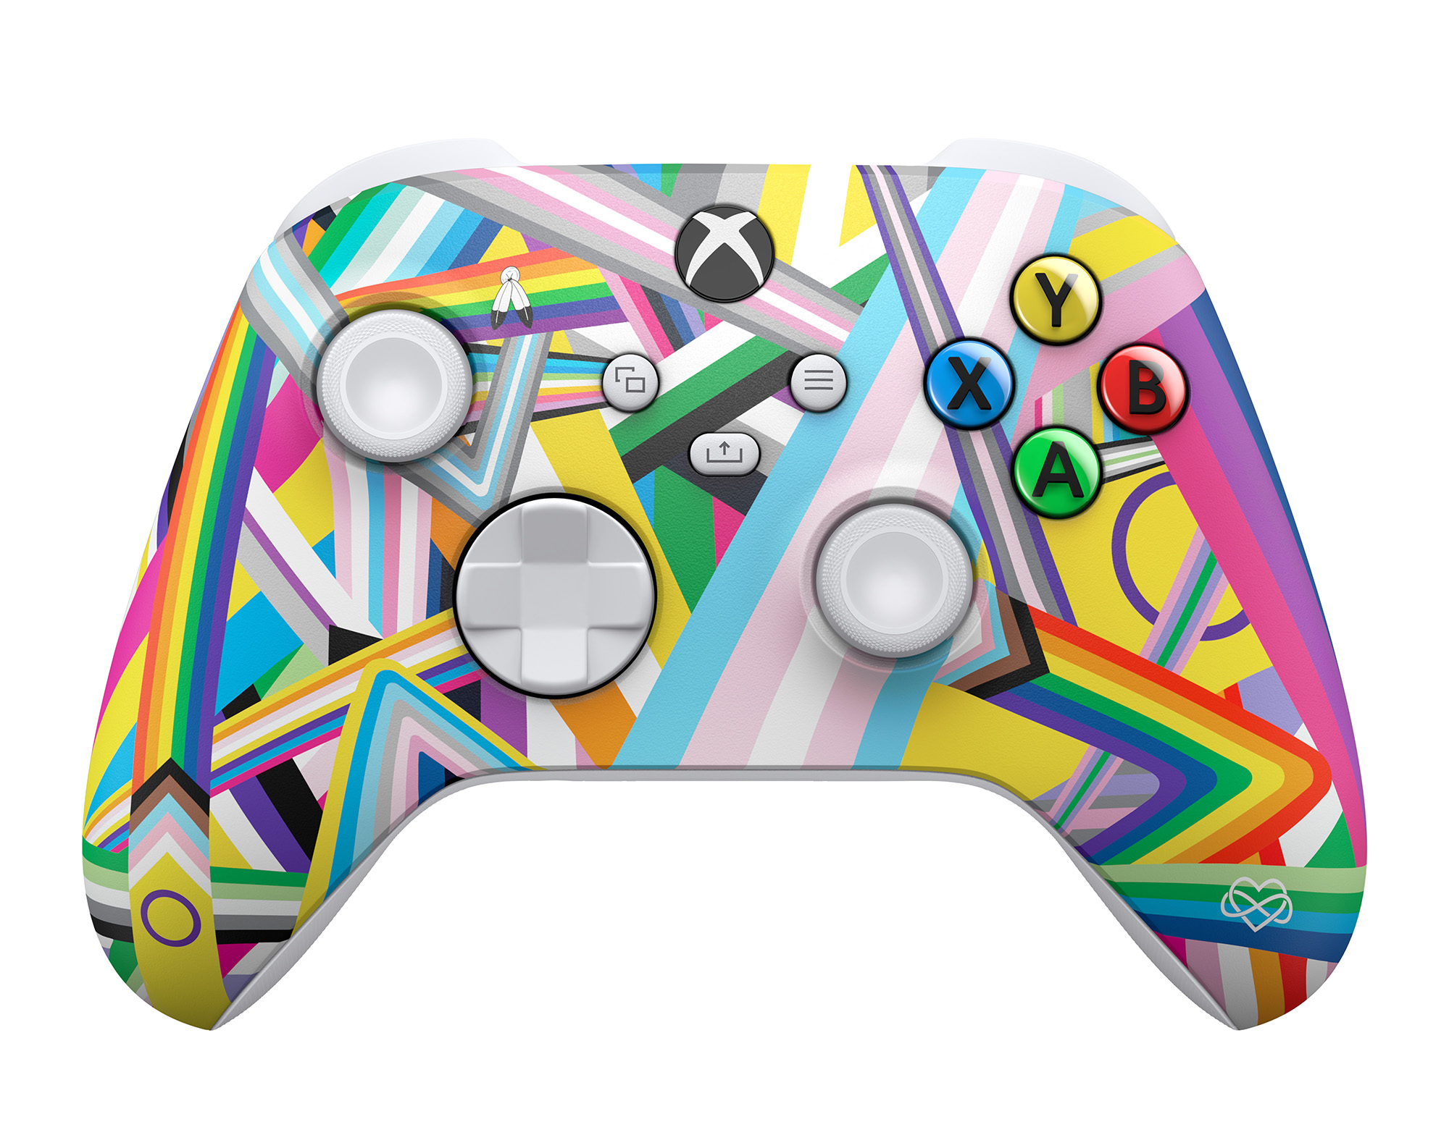

ARCHITECURAL LAYERS IN ACTION
Controller Layer @Controller
Admin
Test
User

Slide 14

ARCHITECURAL LAYERS IN ACTION
Service Layer: @Service
Admin Service
Questions Service
Test Service
User Results Service
User Service

Slide 15

ARCHITECURAL LAYERS IN ACTION
Repository Layer : @Repository
Admin Repository
Questions Repository
Test Repository
User History Repository
User Repository
User Results Repository

Slide 16

ARCHITECURAL LAYERS IN ACTION
Exception Layer:
InvalidCredentialsException
UnAcceptableInformationException
UserNotFoundException
UserUpdateException

Slide 17

CHALLENGES FACED
In the task of making the “user” to submit the answers we were faced the great challenge in storing the selected answers .
Making the “user” to enroll the test based on the credentials and make him to attempt the test and give the results to the user based on the test.
While doing the User Dashboard.

Slide 18
SCRUM MEETING
Daily we had discussed about the project and tasks assigned to our team members from starting day of the project.
Assigning different tasks to the teammates and ask for the accomplishments for the particular task and if they were left behind help them to be updated.
Asking questions everyday on the project and subject and help ourselves to get better knowledge.
Concepts explanation and clearing doubts of the project for the task and resolving the errors in the code which we were faced.
At End of the day we will have team discussion in the class about the assigned task will update the task status.

Slide 19
CONCLUSION
Project includes total back-end development .
User can attempt any number of available tests for any number of times and he don’t need to tense about the time limit.
We make it user-friendly from the back-end that he can attempt write and check the wrong and right answers.
Admin can add as many as tests that he want and can make available to the user.

Slide 20
FUTURE ENHANCEMENTS
The main requirement for the test is need to develop the front-end to create the user-friendly interface.
The interface may be created by the angular or Html based on the requirement.
The project is need to be dumped into the cloud to get the vast database .
Timer is need to be created for the test after creating the front-end for the project and make user to write the test within that interval.

Slide 21

QUESTIONS PLEASE

Slide 22


